Slide 1
Talent 4.0 – Talent Management for SMEs Training Programme
https://t4lent.eu

Slide 2
M5: How to retain your Employees Unit 2: Career Development Plan
Prepared by FVEM, Spain

Slide 3
Learning Outcomes
This module has the objective to help and guide learners in the following points:
Why career development is so important.
Career development related to performance management in the company.
Ways of developing workers' talents.
2018-1-AT01-KA202-039242

Slide 4
Introduction
As your company grows, your employees should grow with it.
With the job market as competitive as it is, it’s more important than ever to invest back in the people who helped you reach your success in the first place.
One of the most popular ways to do this is to create and implement a career development plan for your employees.
2018-1-AT01-KA202-039242

Slide 5
Defining Career Development
Career development plan definition
A career development plan is a personalized strategy used to assist employees in achieving their career goals. A career development plan consists of short and long-term goals related to the employee’s job and should incorporate employee’s strengths and future career aspirations.
An easy way to discover which of your employees want to prioritize their career development is to use an employee satisfaction survey. Asking specific questions about career planning during a survey can give you invaluable insight into what your employees are really after.
2018-1-AT01-KA202-039242

Slide 6
Defining Career Development
Why should you invest in your employees?
30% of employees feel undervalued in their current position.
That's a large portion of the workforce that doesn't feel as though they're being heard.
And according to research from Work Institute, those feelings of not being appreciated can have serious consequences.
Their research shows that the second most popular reason employees give for quitting their job is lack of professional development and opportunities for growth.
2018-1-AT01-KA202-039242

Slide 7
Benefits of a Career Development Plan
BENEFITS:
Retain Top Talent.
Improve Employee Engagement and Productivity
Strengthen the Succession Pipeline
Generate Knowledge Transfer and Retention
Fill Internal Skill and Role Gaps
Create Positive Employer Branding

Slide 8
Benefits of a Career Development Plan
BENEFITS:
1. Retain Top Talent
Top class organizations understand the need to retain their top talent. But the cost of retaining top talent can run in the hundreds of thousands of euros of company expenses. Additional costs associated with retaining talent include:
The loss of company knowledge
The disruption of customer service
The loss of employee engagement
Career development opportunities ensures that valuable individuals are more likely to look within the organization when they desire a job shift.

Slide 9
Benefits of a Career Development Plan
BENEFITS:
2. Improve Employee Engagement and Productivity
Today's employees expect to find meaning and direction in their day-to-day work. They are not simply looking for jobs and tasks, but also meaningful careers and career goals.
Employees who have access to career development processes, resources and tools feel much more engaged and supported by the organization. In addition, employees who drive their own development are more likely to be motivated and productive on a consistent basis.

Slide 10
Benefits of a Career Development Plan
BENEFITS:
3. Strengthen the Succession Pipeline
The backbone of any effective succession planning process is a readily available talent pipeline.
An employee-driven career development initiative gives your top talent the opportunity to apply for critical roles that may be vacant.
Making such opportunities visible and available for all eligible employees ensures that the most qualified individuals enter in those critical roles.
.

Slide 11
Benefits of a Career Development Plan
BENEFITS:
4. Generate Knowledge Transfer and Retention
The ongoing retirement of Baby Boomers makes it is crucial for organizations to retain the knowledge and experience of seasoned employees.
Career development initiatives aimed at retaining experienced talent provide direct opportunities for knowledge sharing.
This promotes enhancing and tapping into knowledge capital within an organization and ensuring that such valuable knowledge is not lost.

Slide 12
Benefits of a Career Development Plan
BENEFITS:
5. Fill Internal Skill and Role Gaps
Skill and competency gaps are becoming more common as roles become more demanding and the demands of leadership grow increasingly complex.
Creating a culture that facilitates internal mobility is one of the best ways to fill these gaps from within the organization.
An internal mobility framework enables qualified employees to find roles most suited to them.
It also enables the organization to fill such roles without the extensive costs associated with hiring, training, and onboarding outside hires.

Slide 13
Benefits of a Career Development Plan
BENEFITS:
6. Create Positive Employer Branding
Organizations that achieve sustainable success are those that attract the best people to develop their strategies and achieve their goals.
An effective career development initiative brands your organization as one that truly cares about its employees.
This helps your organization attract the best people for the roles you need.

Slide 14
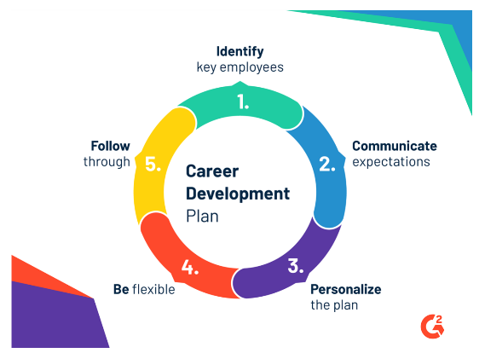
How to create a PLAN of CD
2018-1-AT01-KA202-039242

Slide 15
How to create a PLAN of CD
1. Identify employees that you think are ready for career advancement
List employees that you think are ready for the next step in their career
high-performers
employees that have shown a great deal of potential.
You can ask managers of each department to help you.
Once you have a list of employees you should be focusing on, it’s time to create a tailored career development plan to fit each of their needs.
2. Set a meeting and expectations with your employee
Once you’ve created a list of employees that are ready for some personalized career planning, you’ll want to alert them of the process.
Send the employee an email
Schedule a quick 15 minute meeting to go over your plans for their employee development plan. During this first meeting you should recommend some ways the employee can begin preparing for their career development plan.
2018-1-AT01-KA202-039242

Slide 16
How to create a PLAN of CD
3. Personalize each plan based on the individual employee
The most important thing is to personalize it for each employee.
Set professional and personal goals
These should be tailored to their current position and experience level.
4. Be prepared to be flexible
You should come prepared with a list of ideas and career development goals that are generic enough that they will help anyone with their career planning. For example, leadership courses, writing workshops, etc.
This way you can continue on with your career planning process while you restructure your plan to fit the employee’s career aspirations.
2018-1-AT01-KA202-039242

Slide 17
How to create a PLAN of CD
5. Create an actionable plan and follow through
Once you have an agreed career development plan, it’s time to put it into action.
It is advisable be accessible for employees to discuss ideas they have for their career development.
It is important to follow up the career development plan every quarter to discuss the progress.
It’s key to track the progress of employees who take their career development plan seriously and ensure that the right managers know about their progress.
You cannot promise a promotion or raise to an employee for their participation in a career development plan, but you can let the right people know that they deserve one.
2018-1-AT01-KA202-039242

Slide 18
Exercises
Many employees assume that if they want to advance, they need to go somewhere else instead of staying at their company.
Do you think this reasoning is accurate?
What do you think are the benefits of staying in the same company?
“Career Services are only for seniors”
Do you agree?
2018-1-AT01-KA202-039242

Slide 19
2 mistakes to avoid when creating a career development plan
1. Don’t make any promises
Don’t make any promises you can’t keep.
Instead, focus on short-term goals that show their progress in their career advancement. This gives your employee something tangible they can work on and allows you to make changes with flexibility if future plans change.

Slide 20
2 mistakes to avoid when creating a career development plan
2. Don’t do the work for them
Empower your employees to take their career into their own hands
Allow them to take charge of how their career planning.
Each employee is the only responsible of their own career development.
Finding seminars and workshops for the employee
Schedule meetings with the manager
…
An employee that is focused on career advancement won't need hand-holding in order to get the job done.

Slide 21
How to follow up a career development plan: Performance Management Process
1. Set goals effectively
2. Begin with performance planning
3. Create an ongoing process
4. Improve productivity through better goal management
5. Gather information from multiple sources
6. Document, document, document
7. Prepare and train your managers
8. Perfect the performance review
9. Link performance with rewards and recognition
10. Encourage full participation and success

Slide 22
How to follow up a career development plan: Performance Management Process
1. Set goals effectively:
Making a goal specific, measurable, and time bound contributes to the ability to make progress on the goal and track that progress.
S – Specific
M – Measurable
A – Achievable/Attainable
R – Results-Oriented/Realistic/Relevant
T – Time-Bound
2. Begin with performance planning
Using the performance plan as a reference document, the employee and manager then should regularly monitor progress against goals, problem-solve roadblocks, re-assess goals, change goals as business direction changes, and re-evaluate training and resource needs. This is where the conversation is critical and often where the follow-through sometimes falls down. Performance planning and ongoing performance feedback are critical because they facilitate continuous improvement and aid open communication.

Slide 23
How to follow up a career development plan: Performance Management Process
3. Create an ongoing process:
Performance management – including goal setting, performance planning, performance monitoring, feedback and coaching – should be an ongoing and continuous process, not a once or twice-yearly event.
4. Improve productivity through better goal management:
Regular goal tracking allows for the opportunity to provide feedback as needed, make adjustments to performance plans, tackle obstacles and prepare contingencies for missed deadlines.
5. Gather information from multiple sources:
Organizations will often use a 360° feedback process. Along with the completion of a self-assessment, selected peers, subordinates, and manager(s) are asked to contribute feedback around pre-identified areas. The feedback is based upon specifically identified skills or competencies and the final results are compared against the employee's self-assessment. This type of feedback increases self-awareness and in some cases is used to support the performance evaluation process.

Slide 24
How to follow up a career development plan: Performance Management Process
6. Document, document, document
Note-taking must be consistent and include all significant occurrences, positive or negative. Documentation is important to support performance decisions, and notes should be written with the intent to share.
7. Prepare and train your managers
Training may be required to ensure managers feel adequately prepared to effectively complete all the tasks related to performance management.
Managers need to understand human behavior, how to motivate, how to develop, provide coaching and deal with conflict.
8. Perfect the performance review
The employee performance appraisal or review should be a summary of all that has been discussed. Based upon job expectations and key areas of contribution, and previously discussed goals and evaluation methods, the appraisal should be a written confirmation of what has already been discussed with the employee.

Slide 25
How to follow up a career development plan: Performance Management Process
9. Link performance with rewards and recognition.
Organizations are linking performance to compensation. This link, however, cannot effectively be established without the existence of sound performance management processes that are seen as fair and equitable.
For example, some companies use Motivosity social platform (www.motivosity.com), a social platform where employees can give each other small monetary bonuses for doing great things. Motivosity provides an easy way for employees and managers to thank each other with small monetary rewards for the great work that is being done.
10. Encourage full participation and success.
The performance management process must add value, otherwise problems with resistance and non-participation will surface. In addition, the process itself must be as efficient and simple as possible. Automated reminders and scheduling tools can help keep the process on track.

Slide 26
How to follow up a career development plan: Performance Management Process
7Geese
https://7geese.com/
7Geese is an Objectives and Key Results (OKRs) and Performance Management application. The integrated platform merges goal-setting with sustained 360 feedback, coaching, and core values -based recognition in order to help organizations boost employee performance. This application has powerful and effective tools to help users monitor and manage individual, team, and organization performances in real time. A peer-driven social recognition program intends to advocate a supportive and fun environment at work. The integration with top human resource applications allows users to streamline employee management workflows. Organizations are assured that all their data is kept secure through 7Geese’s 256-bit encryption. The application is also scalable so that companies can keep using the software as their business grows.

Slide 27
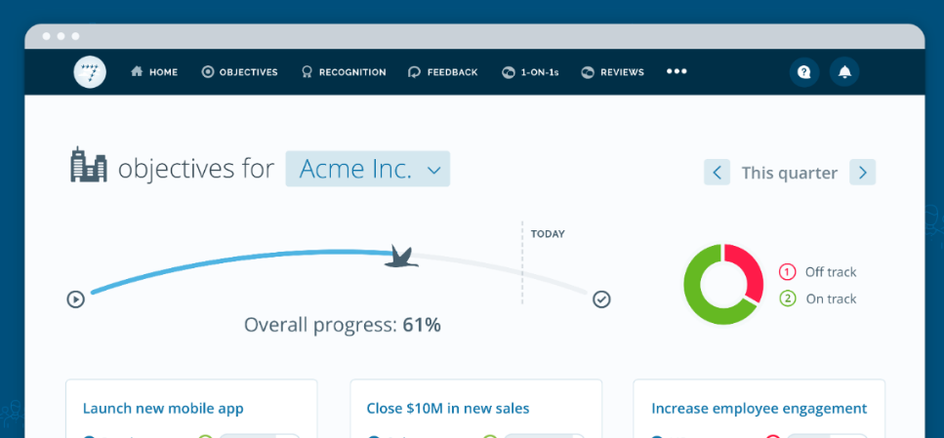
7Geese
https://7geese.com/

Slide 28
Video: You're Always On - Your Career Development Cycle
Discussion:
To what extend is employee responsibility his/her career development?

Slide 29
Summary/Conclusion
Career development is a vital exercise that cannot be ignored. Current technological innovation and globalization, with prevailing competitor among corporate organizations have made the world of work excessively active, requiring up-to-date attitudes, knowledge and skills.
To survive in the world of work, the organization and the employee must not leave career development to chance, Career development is a joint activity between the individual employee and the organization.
2018-1-AT01-KA202-039242

Slide 30
Resources and working materials
ECVET;
https://nsucurrent.nova.edu/2017/11/28/debunking-the-myths-of-career-development-services/
Gyansah, S. T., & Guantai, H. K. (2018). Career development in organisations: Placing the organisation and the employee on the same pedestal to enhance maximum productivity. European Journal of Business and Management, 10(14), 40-45.
https://www.linkedin.com/pulse/career-development-vs-performance-management-ed-smith/ https://www.ukessays.com/essays/management/purpose-and-benefits-of-career-development-management-essay.php
https://learn.g2.com/career-development-plan
Abbott, J. A., Klein, B., Hamilton, C., & Rosenthal, A. J. (2009). The impact of online resilience training for sales managers on wellbeing and performance. Sensoria: A Journal of Mind, Brain & Culture, 5(1), 89-95.
2018-1-AT01-KA202-039242

Slide 31
2018-1-AT01-KA202-039242

