Slide 1
Talent 4.0 – Talent Management for SMEs Training Programme
https://t4lent.eu/
2018-1-AT01-KA202-039242

Slide 2
M4: How to motivate your Employees Unit 1: Employee Motivation – in theory
Introduction Video
Prepared by IHK-Projektgesellschaft www.ihk-projekt.de Germany
2018-1-AT01-KA202-039242

Slide 3
Learning Outcomes
This module wishes to guide and help learners:
Understand the role of motivation in determining employee performance.
Abraham Maslow's hierarchy of needs
What motivates employees?
Classify the basic needs of employees
2018-1-AT01-KA202-039242

Slide 4
Learning Outcomes
This module wishes to guide and help learners:
Understand the role of motivation in determining employee performance.
Abraham Maslow's hierarchy of needs
What motivates employees?
Classify the basic needs of employees
2018-1-AT01-KA202-039242

Slide 5
Learning Outcomes
This module wishes to guide and help learners:
Understand the role of motivation in determining employee performance.
Abraham Maslow's hierarchy of needs
What motivates employees?
Classify the basic needs of employees
2018-1-AT01-KA202-039242

Slide 6
Introduction
When you're motivated, you feel energized. You're ready to take things on, get things done, push things forward. Projects get moved along; emails get answered; you move along with pep in your step.
When you're unmotivated, it's hard to get started. You drag your feet, push things off, and slow things down. You don't really want to do the project, write the email, or go to the meeting ... so you don't. For a long time. Maybe you don't even go at all.
The fact is, knowing how to motivate your team is one of the most important parts of leadership.
https://www.inc.com/melanie-curtin/what-motivates-you-at-work-when-200000-workers-were-asked-this-was-their-top-reponse.html
2018-1-AT01-KA202-039242

Slide 7
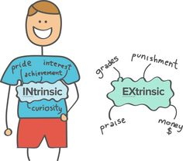
Motivation is the word derived from the word ’motive’ which means needs, desires, wants or drives within the individuals. It is the process of stimulating people to actions to accomplish the goals.
In the work goal context the psychological factors stimulating the people’s behaviour can be
desire for money
success
recognition
job-satisfaction
team work, etc
One of the most important functions of management is to create willingness amongst the employees to perform in the best of their abilities. Therefore the role of a leader is to arouse interest in performance of employees in their jobs.
Source: https://www.managementstudyguide.com/what_is_motivation.htm
2018-1-AT01-KA202-039242

Slide 8
Defining Employee Motivation
Motivation is one of the forces that lead to performance. Motivation is defined as the desire to achieve a goal or a certain performance level, leading to goal-directed behavior.
When we refer to someone as being motivated, we mean that the person is trying hard to accomplish a certain task. Motivation is clearly important if someone is to perform well; however, it is not sufficient.
Being motivated is not the same as being a high performer and is not the sole reason why people perform well, but it is nevertheless a key influence over our performance level. Motivation, ability, and environment are the major influences over employee performance.
Performance
Motivation
Ability
Environment
=
+
+
Performance is a function of the interaction between an individual’s motivation, ability, and environment.
2018-1-AT01-KA202-039242

Slide 9
Defining Employee Motivation
Ability—or having the skills and knowledge required to perform the job—is also important and is sometimes the key determinant of effectiveness.
Finally, environmental factors such as having the resources, information, and support one needs to perform well are critical to determine performance. At different times, one of these three factors may be the key to high performance.
Performance
=
Motivation
Ability
+
Environment
+
Performance is a function of the interaction between an individual’s motivation, ability, and environment.
2018-1-AT01-KA202-039242

Slide 10
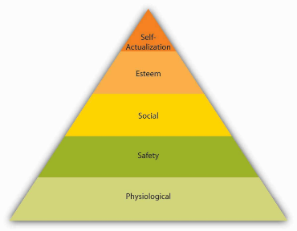
Maslow’s Hierarchy of Needs
Abraham Maslow is among the most prominent psychologists of the twentieth century. His hierarchy of needs is an image familiar to most business students and managers. The theory is based on a simple premise: Human beings have needs that are hierarchically ranked.
The most basic of Maslow’s needs are physiological needs. Physiological needs refer to the need for food, water, and other biological needs. These needs are basic because when they are lacking, the search for them may overpower all other urges.
2018-1-AT01-KA202-039242

Slide 11
Maslow’s Hierarchy of Needs
Maslow´s hierarchy is a systematic way of thinking about the different needs employees may have at any given point and explains different reactions they may have to similar treatment.
An employee who is trying to satisfy esteem needs may feel gratified when her supervisor praises an accomplishment. By making the effort to satisfy the different needs of each employee, organizations may ensure a highly motivated workforce.
2018-1-AT01-KA202-039242

Slide 12
What motivates employees?
What are the tools companies can use to ensure a motivated workforce?
Many of us assume the most important motivator at work is pay. Yet, studies point to a different factor as the major influence over worker motivation — job design.
How a job is designed has a major impact on employee motivation, job satisfaction, commitment to an organization, absenteeism and turnover.
The question of how to properly design jobs so that employees are more productive and more satisfied has received attention from managers and researchers since the beginning of the 20th Century.
2018-1-AT01-KA202-039242

Slide 13
Source : TALENT4.0 ONLINE LTTA 25.06.2020
2018-1-AT01-KA202-039242

Slide 14
Stereotypes?
Traditionalists
Traditionalist are motivated by money, but also want to be respected.
Baby Boomers
Baby boomers prefer monetary rewards, but also value flexible retirement planning and peer recognition.
Five generations work side by side in today’s workforce, making it important to create an inclusive culture that meets the varying needs of each age group.
Members of each generation bring a distinct set of values, attitudes and behaviors to the workplace.
The multigenerational workforce requires flexible leadership, policies and programs.
Generation X
Generation X values bonuses and stock as monetary rewards and workplace flexibility as a non-monetary reward.
Generation Y
Generation Y wants stock options as a monetary reward and values feedback as a non-monetary reward.
Generation Z
Generation Z is more interested in social rewards (mentorship and constant feedback) than money, but also is motivated by meaningful work and being given responsibility.
Source: https://www.shrm.org/ResourcesAndTools/hr-topics/behavioral-competencies/global-and-cultural-effectiveness/Pages/Motivating-Generations-Infographic.aspx
2018-1-AT01-KA202-039242

Slide 15
What motivates employees?
What are the tools companies can use to ensure a motivated workforce?
Core Job Characteristics
Psychological States
Outcomes
- Skill variety - Task identity - Task significance - Autonomy - Feedback
- Meaningfulness - Responsibility - Knowledge of results
- Motivation - Performance - Satisfaction - Absenteesim - Turnover
The Job Characteristics Model has five core job dimensions. In 1980, Richard Hackman and Greg Oldham presented the definitive form of the Job Characteristics Model in their book ‘Work Redesign’. Source: https://www.toolshero.com/human-resources-hr/job-characteristics-model/
2018-1-AT01-KA202-039242

Slide 16
Classify the basic needs of employees
Need-based theories describe motivated behavior as individuals’ efforts to meet their needs. The manager’s job is to identify what people need and make the work environment a means of satisfying these needs. Maslow’s hierarchy describes five categories of basic human needs, including physiological, safety, social, esteem, and self-actualization needs.
ERG (Existence Needs, Relatedness Needs, and Growth Needs.) theory is a modification of Maslow’s hierarchy. The theory recognizes that when employees are frustrated while attempting to satisfy higher level needs, they may regress. Each of these theories explains characteristics of a work environment that motivates employees.
Source: https://businessjargons.com/alderfers-erg-theory.html
2018-1-AT01-KA202-039242

Slide 17
Classify the basic needs of employees
Ways in Which Managers Can Influence Expectancy, Instrumentality, and Valence
Expectancy
Instrumentality
Valence
- Make sure employees have proper skills, abilities and knowledge - Ensure that the environment facilitates performance - Provide encouragement to make people believe that their effort makes a difference
- Reward employee performance - Inform people on advance about the rewards - Try to eliminate non-performance influence over rewards
- Find rewards that are desirable to employess - Make sure that the rewards are viewed as fair - Give employees choice over rewards
Source: https://www.businessballs.com/improving-workplace-performance/vrooms-expectancy-theory/
2018-1-AT01-KA202-039242

Slide 18
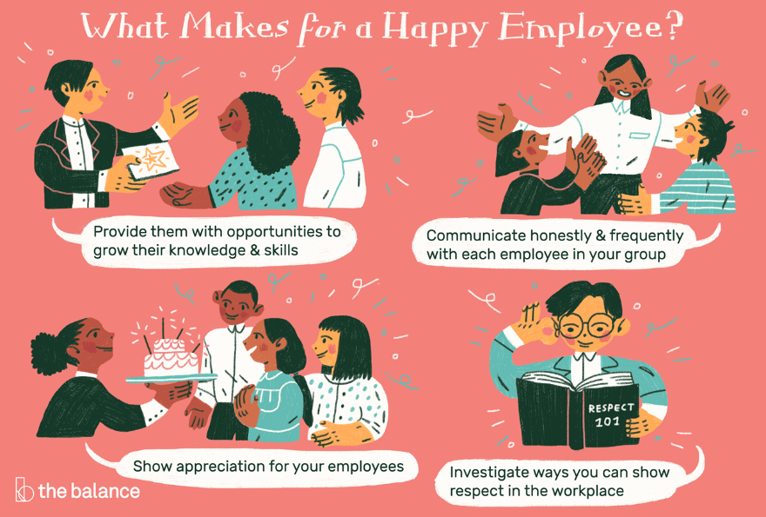
Source : https://www.thebalancecareers.com/how-great-managers-motivate-their-employees-1918772
2018-1-AT01-KA202-039242

Slide 19
What motivates employees to stay ?
48 % a good manager
46 % feeling appreciated by employer
35 % recognition for achievements
39 % opportunity for career growth
38 % promotion or new title
32 % opportunity to develop skills
Source: Cornerstone 2013 U.S. Employee Report
2018-1-AT01-KA202-039242

Slide 20
Exercises
Many managers assume that if an employee is not performing well, the reason must be a lack of motivation. Do you think this reasoning is accurate? What is the problem with the assumption?
How can an organization satisfy employee needs that are included in Maslow’s hierarchy?
2018-1-AT01-KA202-039242

Slide 21
Summary/Conclusion
Employees respond to unfairness in their environment, they learn from the consequences of their actions and repeat the behaviors that lead to positive results, and they are motivated to exert effort if they see their actions will lead to outcomes that would get them desired rewards.
None of the theories are complete on their own, but each theory provides us with a framework we can use to analyze, interpret, and manage employee behaviors in the workplace.
Sources: https://saylordotorg.github.io/text_organizational-behavior-v1.1/s09-theories-of-motivation.html
2018-1-AT01-KA202-039242

Slide 22
Thank you for watching!
2018-1-AT01-KA202-039242

Slide 23
Pictures: 1. Bild von Alexas_Fotos auf Pixabay 2. Bild von Gerd Altmann auf Pixabay 3. Bild von Gerd Altmann auf Pixabay 4. Bild von Peggy und Marco Lachmann-Anke auf Pixabay
2018-1-AT01-KA202-039242

