Slide 1
Talent 4.0 – Talent Management for SMEs Training Programme
https://t4lent.eu/
2018-1-AT01-KA202-039242

Slide 2
Employee Development Unit 2: Setting up an Employee Development Plan
Prepared by CARDET, Cyprus
2018-1-AT01-KA202-039242

Slide 3
Learning Outcomes
Understand the employee development plan process
Understand different forms of employee development plans
Identify steps in designing an employee development-growth plan
2018-1-AT01-KA202-039242
Notes:
This module aims to guide and help learners:
Become aware and understand the process of employee development plan
Grasp the different forms of employee development plan
Be in a position to identify the steps that need to be taken in designing an employee development-growth plan

Slide 4
What is an Employee Development Plan?
“An employee development plan, sometimes called an employee growth plan, is a process for helping individuals improve skills for their current job and acquire knowledge and skills for new roles and responsibilities in an organization.” (Peterson:2020)
Note: If the professional development opportunities offered don’t appeal to, or benefit the employees, they’ll lose interest and disengage with the program.
2018-1-AT01-KA202-039242
Notes:
“An employee development plan, sometimes called an employee growth plan, is a process for helping individuals improve skills for their current job and acquire knowledge and skills for new roles and responsibilities in an organization.” (Peterson:2020)
It helps ensure that the growth of employees is promoted in a ‘structured’ way, assisting them to develop their ability to achieve more in the workplace and contribute to the organisation’s goals.
Note: If the professional development opportunities offered don’t appeal to, or benefit the employees, they’ll lose interest and disengage with the program.

Slide 5
What is an Employee Development Plan?
An action plan for employee growth and empowerment
A ‘live document’ constantly evaluated
Steps needed by an organization to enhance employee skills and motivation for acquiring new knowledge and leaning
2018-1-AT01-KA202-039242
Notes:
An employee development plan operates as an action plan for the growth and empowerment of an employee and is a ‘live document’ that is being constantly evaluated and if needed, amended.
It lays down the steps an organization should take in order to enhance the skills of an employee and motivate him/her to acquire new knowledge and leanings.
Note: Tailoring the plan to reflect your unique workforce is critical. When developing an employee development plan it is essential that the realities and needs of the company as well as the particularities of the employee in question (e.g. his/her learning style or preferences) are taken into account

Slide 6
Why is it important to have an Employee Development Plan?
Acts as a roadmap
Supports employees with career and personal development
Helps a company identify key roles and needs
Ensures a two-way communication to achieve common goals.
2018-1-AT01-KA202-039242
Notes:
A development plan acts as a roadmap for employees and helps to support them in their career and personal development.
It helps a company identify key roles and needs so that it can invest in supporting its employees to grow their talent and fill skills gaps.
It helps ensure that there is a two-way communication and dialogue, assisting both the company and the employees to achieve common goals.

Slide 7
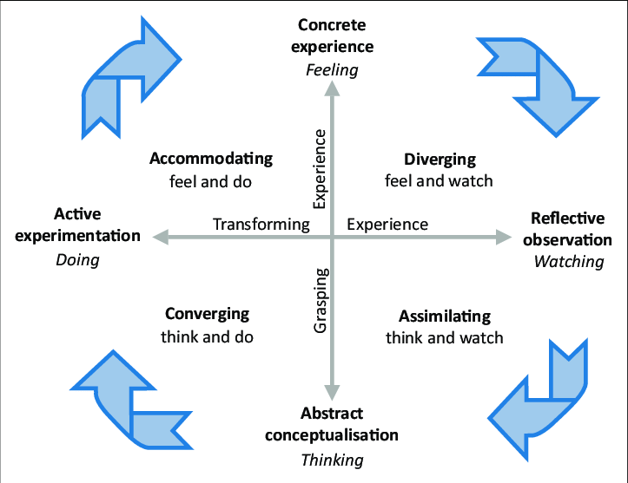
Things to keep in mind
No one-size-fits-all solution in learning and development plans as every employee is different.
https://www.businessballs.com/self-awareness/kolbs-learning-styles/
2018-1-AT01-KA202-039242
Notes:
There is no one-size-fits-all solution when it comes to learning and development plans as every employee is different.
Scientific research such as Kolb’s learning styles theory, shows that people have different preferred ways of learning. Mumford & Honey’s theory of learning styles is very similar and their learning styles questionnaire (found with this Module’s worksheets) can be a valuable tool for self-awareness and for devising an EDP

Slide 8
Things to keep in mind
Each plan should be tailored in-line with employee’s needs and current and future role.
EDPs provide development opportunities through daily work.
2018-1-AT01-KA202-039242
Notes:
Each employee development plan should be tailored in-line with the employee’s needs and his/her current and future role.
It is important that employees don’t view employee development plans as separate to their daily work lives, as something to be done in their ‘free time.’ Used properly, EDPs provide development opportunities through daily work.

Slide 9
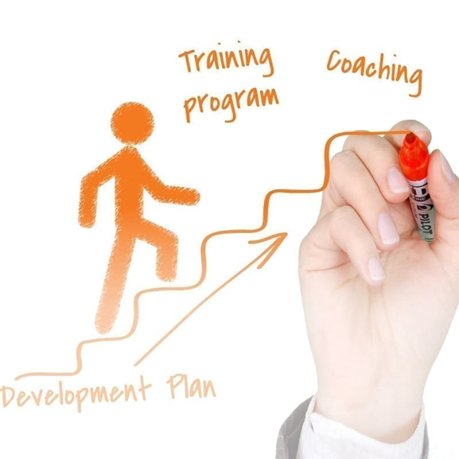
Things to keep in mind
Provide real world experiences.
Referring back to this working document helps establish its importance.
Review the EDP regularly
Ensure employees are motivated to participate in the process
Employee-led and manager-driven.
Development doesn’t always equal formal learning.
2018-1-AT01-KA202-039242
Notes:
Employees should be made to work on live projects which would provide them real world experiences. This way employee learns new skills while on the job.
Codifying the plan, using it as a working document and referring back to it helps establish its importance.
Conduct regular reviews of the development to assess their effectiveness and how can the development plan can be improved.
Make sure

Slide 10
Developing an Employee Development Plan
Employee development plans should be created keeping in mind the following things:
What skills does the employee possess?
What are his his/her key responsibility areas/job responsibilities?
What skills does he/she need to acquire to be more productive?
In what aspects of the company, aside from his/her current profile can he/she contribute?
Not only to focus on an employee’s current job responsibilities but also think of his/her potential.
His/her personal and professional goals.
2018-1-AT01-KA202-039242

Slide 11
Developing an Employee Development Plan
A successful development plan needs:
employee engagement
motivating organizational purpose
encouraging staff to take ownership
2018-1-AT01-KA202-039242
Notes:
To have a successful development plan, employee engagement – buy-in from your employees must play a crucial part in driving the process. They need to be consulted and their opinions and suggestions need to be taken into consideration throughout this process. This can be done via personal meetings or questionnaires through which they can also suggest activities that can help them develop.
The key to effectively implementing an employee growth and development plan is to create a purpose for the organisation that motivates employees to be active in working towards and supporting it.
Encouraging your staff to take ownership of this plan will allow them to respond positively when working for the business.

Slide 12
Types of employee development Plans
Professional Growth Plans for career development
Performance Improvement Plans to help under performing employees
2018-1-AT01-KA202-039242
Notes:
There are two main types of employee development Plans:
Professional Growth Plans, specifically developed to help individuals in their career growth
Performance Improvement Plans, to help employees improve their performance. In such programmes, underperforming employees are supported with an action plan to get back on track with their performance and meet their expected objectives

Slide 13
What should one include?
Career development goals:
growth-oriented
skills-oriented
relationship-oriented
Work development needs:
What are the role demands ?
aligned to organisational goals,
future role demands
future positions available in the organisation
An action plan: Mapping a path for the expected development
2018-1-AT01-KA202-039242
Notes:
Career development goals: These goals could be growth-oriented, skills-oriented and relationship-oriented (e.g. assertiveness). The best plans will include goals in more than one area
Work development needs: This involves an objective look at the demands of the role initially, to ensure the employee development plan is aligned to organisational goals, and also at the future demands of the role (how it will evolve) and future positions available in the organisation (for succession planning).
An action plan: Once the alignment has been established and the areas for development identified, the path to this development needs to be mapped out.

Slide 14
Essential Steps to Creating an Employee Development Plan
Step 1: Think about business goals
Step 2: Talk to your employees
Step 3: Recognize potential vs. readiness
Step 4: Consider the skills and training needed by each worker
Step 5: Explore and identify opportunities and approaches that can be used
Employee Development Plan Checklist: 4 Winning Steps to Engaged Employees
2018-1-AT01-KA202-039242
Notes:
Step one: Think about business goals - Before you set objectives for employee development plan, try to align their development needs with your company’s business needs by considering your long- and short-term business objectives. Once you’ve identified your objectives you can identify the necessary skills, knowledge and competencies that support those goals.
Step two: Talk to your employees - Don’t assume you know your employees’ skill level and career aspirations. Talk with each of your team members to get a better understanding of what their career goals are. You should also ask your employees to assess their own work and discuss any challenges they’re having in their current position and what type of additional training, mentoring or assignment do they feel that would benefit them. By talking to employees, you can work together to figure out what role your business can play in their plans as well as what opportunities you can offer them.
Step three: Recognize potential vs. readiness - As you assess your staff, it’s important to remember that there’s a difference between potential and readiness. An employee may have the capacity and potential but lack the motivation and drive to undergo training and the development process to fulfil them. Readiness comes in a variety of forms, encompassing desire, skills and experience. Keep in mind that not every employee wants to – or should – move into management, no matter how good they are in their current position.
Step four: Consider the skills and training needed by each worker - By evaluating each of your employees' abilities and experience, as well as your company's needs, it is important to explore and decide exactly what skills each person needs to acquire.
Step Five: Explore and identify opportunities and approaches that can be used
Having set the objectives of a development plan, it is also important to figure out how should the employee acquire their new skills. An holistic solution involves nurturing new hard skills as well as developing soft skills, and providing continuous feedback. An employee training and development plan will encompass all of this while presenting realistic, obtainable opportunities for career development and improving the employee experience through company culture and engagement.

Slide 15
Summary/Conclusion
Employee development plans are action plans.
No one-size-fits-all solution.
Conduct regular reviews of the development to assess effectiveness of the development plan and how it can be improved.
Two types of employee development Plans:
Professional Growth Plans
Performance improvement plans
They must include
Career development goals
Work development needs
Plan for action
2018-1-AT01-KA202-039242
Notes:
Employee development plans are action plans, working documents used actively by both the employee and line manager to ensure that an employee is ‘growing’.
There is no one-size-fits-all solution when it comes to learning and development plans as every employee is different.
Conduct regular reviews of the development to assess their effectiveness and how can the development plan can be improved.
There are two types of employee development Plans: Professional Growth Plans and performance improvement plans.
An employee development plan should feature career development goals, Work development needs and an action plan.

Slide 16
References – Additional Reading
Investors in People ‘Employee Development Plan – Everything you need to know’
Kent Peterson (2020) ‘Employee Development Plans: 4 Winning Steps to engaged employees’
WalkMe (2017) ‘Top 4 Employee Development Plan Examples’
Management Guide Style ‘Employee Development Plan’
Get Smarter (2019) 7 steps to creating an employee Development Plan
https://www.businessballs.com/self-awareness/kolbs-learning-styles/
2018-1-AT01-KA202-039242

Slide 17
References – Additional Reading
Society for Human Resource Management ‘Developing Employees’
John Spacey (2018) ‘4 Examples of a Personal Development Plan’
Insperity ‘5 steps to creating career development plans that work’
Continu ‘Creating an Employee Development Plan’
Monster ‘How do I construct an employee development plan?’
Terra Staffing ‘The Best Employee Development Plan Templates’
2018-1-AT01-KA202-039242

Slide 18
Thank you for watching!
2018-1-AT01-KA202-039242

